Slide 1

National University of Computer and Emerging Sciences
Stable Diffusion Model
AI-5004 Adv. Topics in Generative AI
Dr. Muhammad Nouman Noor
Department of Artificial Intelligence and Computer Science

Slide 2
Goals
Recap of Previous Lecture
Today’s Lecture
Denoising Diffusion Models
Stable Diffusion: Latent Diffusion Model

Slide 3
Recap of Previous Lecture

Slide 4
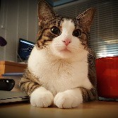
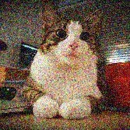
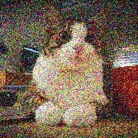
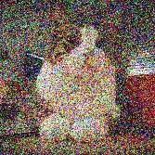
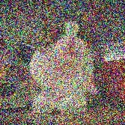
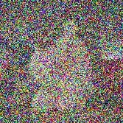
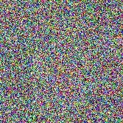
Denoising Diffusion Models
Denoising diffusion models consist of two processes:
Forward diffusion process that gradually adds noise to input
Reverse denoising process that learns to generate data by denoising Forward diffusion process (fixed)
Data
Noise
Reverse denoising process (generative)
Sohl-Dickstein et al., Deep Unsupervised Learning using Nonequilibrium Thermodynamics, ICML 2015 Ho et al., Denoising Diffusion Probabilistic Models, NeurIPS 2020
Song et al., Score-Based Generative Modeling through Stochastic Differential Equations, ICLR 2021
18

Slide 5
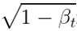
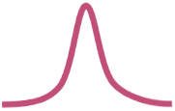
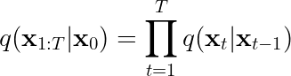
Forward Diffusion Process
The formal definition of the forward process in T steps:
Mean: Variance:
Can be a small value +ve
Forward diffusion process (fixed)
Data
Noise
x₀
x₁
x₂
x₃
x₄
…
x_{T}
(joint)
19

Slide 6
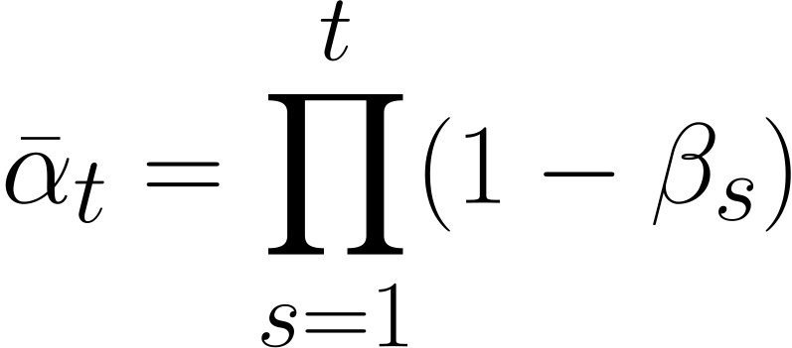
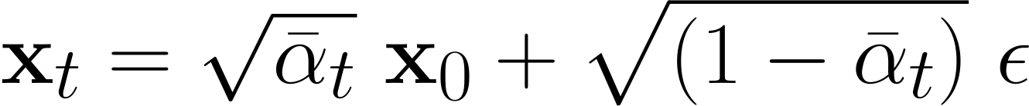
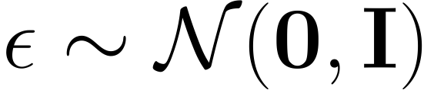
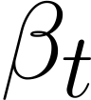
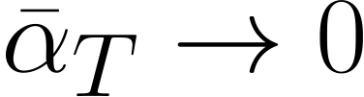
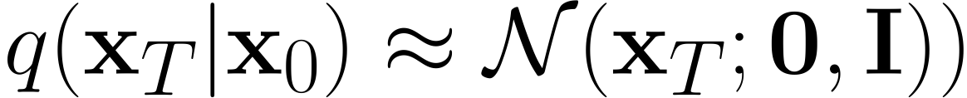
Diffusion Kernel
Forward diffusion process (fixed)
Data
Noise
x₀
x₁
x₂
x₃
x₄
…
x_{T}
Define
For sampling: where
values schedule (i.e., the noise schedule) is designed such that
(Diffusion Kernel)
and
20

Slide 7
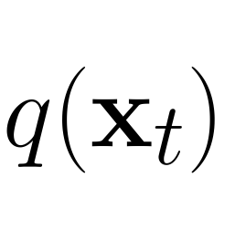
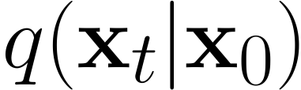
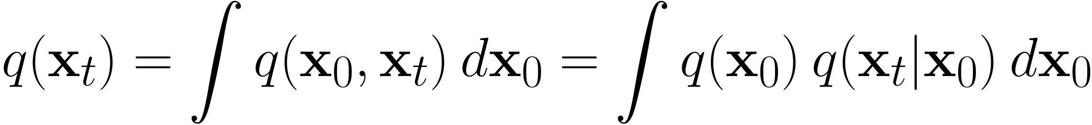
Forward Diffusion
What happens to a distribution in the forward diffusion?
So far, we discussed the diffusion kernel
but what about
?
Diffused data dist.
Joint dist.
Input data dist.
Diffusion kernel
21

Slide 8
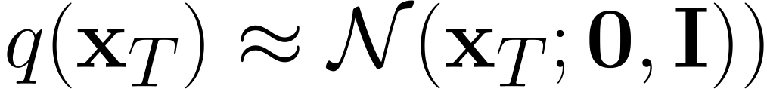
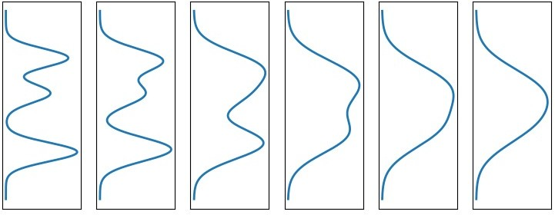
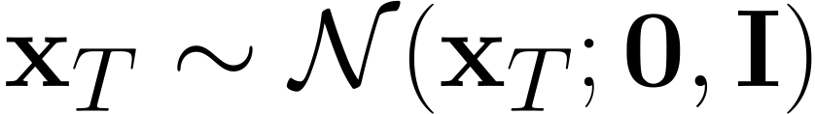
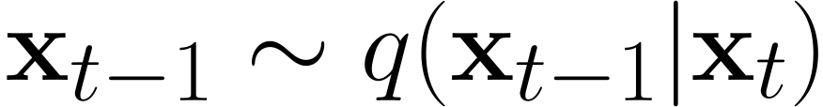





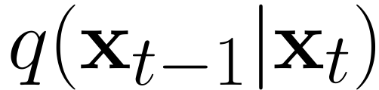
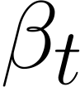
Generative Learning by Denoising
Recall, that the diffusion parameters are designed such that
Diffused Data Distributions
Generation:
Sample
x_{t}
Iteratively sample
True Denoising Dist.
q(x₀)
q(x₀|x₁)
q(x₁)
q(x₂)
q(x₃)
…
q(x_{T})
q(x_{T-1}|x_{T})
In general,
is intractable.
q(x₁|x₂)
q(x₂|x₃)
q(x₃|x₄)
Can we approximate
? Yes, we can use a Normal distribution if
is small in each forward diffusion step.
22

Slide 9
Today’s Lecture

Slide 10
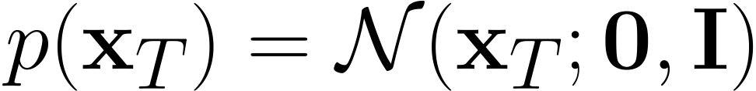
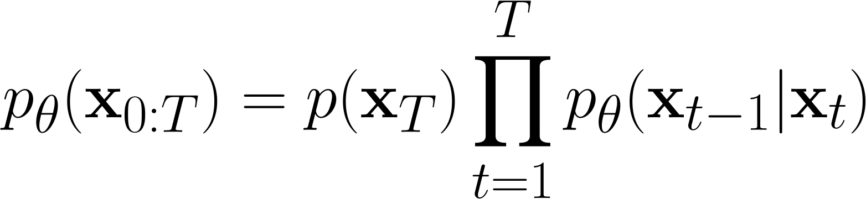
Reverse Denoising Process
Formal definition of forward and reverse processes in T steps:
Reverse denoising process (generative)
Data
Noise
x₀
x₁
x₂
x₃
x₄
…
x_{T}
Trainable network
(U-net, Denoising Autoencoder)
23

Slide 11
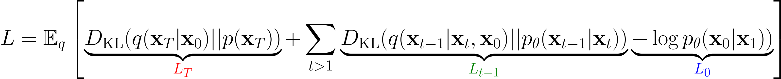
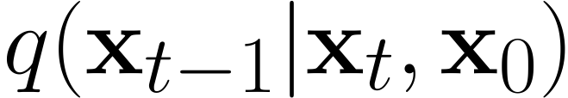
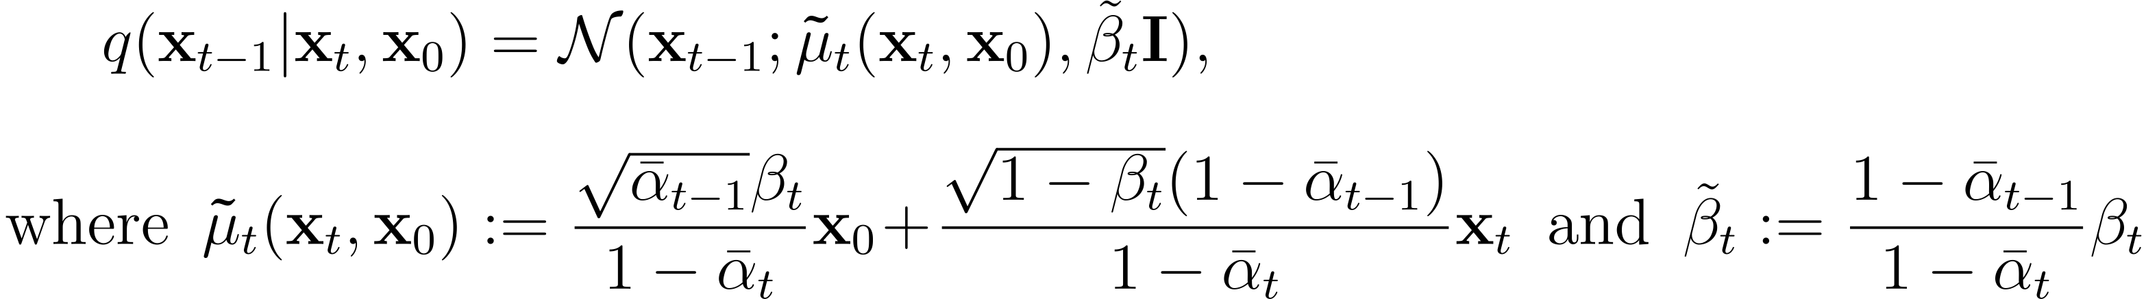
Training Denoising Model
Variational upper bound
For training, we can form variational upper bound that is commonly used for training variational autoencoders:
Sohl-Dickstein et al. ICML 2015 and Ho et al. NeurIPS 2020 show that:
where
is the tractable posterior distribution:
24

Slide 12
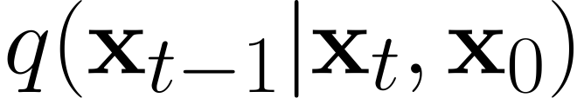
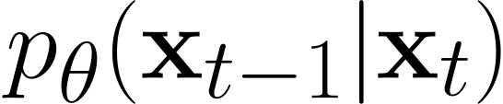
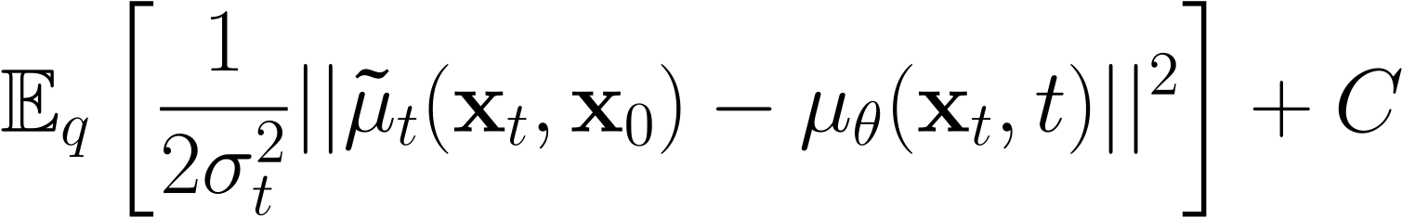
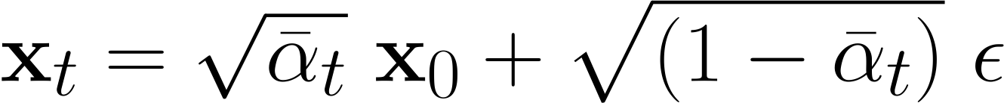
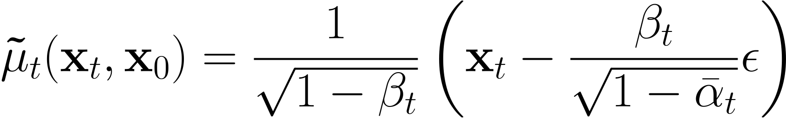
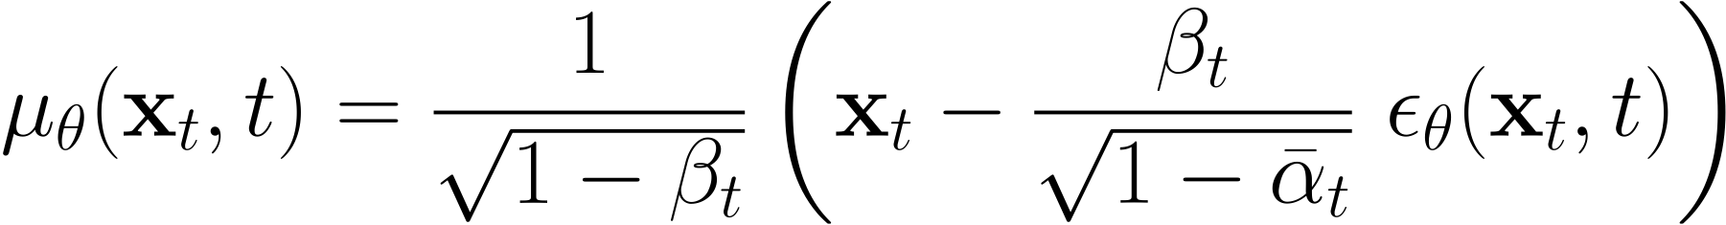
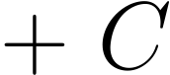
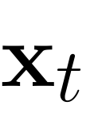
Parameterizing the Denoising Model
Since both
and
are Normal distributions, the KL divergence has a simple form:
Recall that
. Ho et al. NeurIPS 2020 observe that:
They propose to represent the mean of the denoising model using a noise-prediction network:
With this parameterization
25

Slide 13
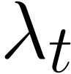
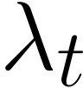
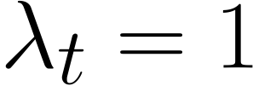
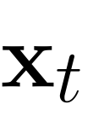
Training Objective Weighting
Trading likelihood for perceptual quality
The time dependent ensures that the training objective is weighted properly for the maximum data likelihood training.
However, this weight is often very large for small t’s.
Ho et al. NeurIPS 2020 observe that simply setting improves sample quality. So, they propose to use:
For more advanced weighting see Choi et al., Perception Prioritized Training of Diffusion Models, CVPR 2022.
26

Slide 14
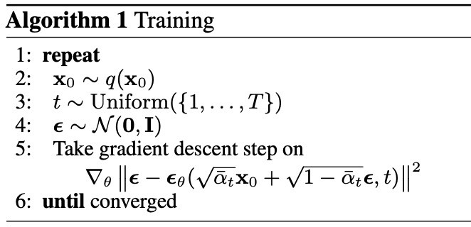
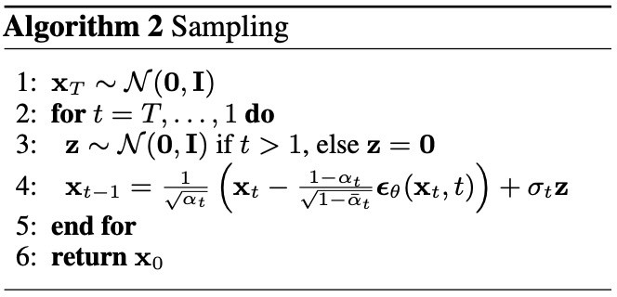
Summary
Training and Sample Generation
27

Slide 15
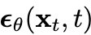
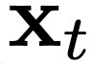
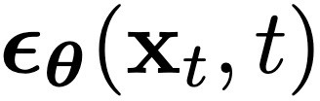
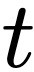
Implementation Considerations
Network Architectures
Diffusion models often use U-Net architectures with ResNet blocks and self-attention layers to represent
Time Representation
Fully-connected Layers
Time representation: sinusoidal positional embeddings or random Fourier features.
Time features are fed to the residual blocks using either simple spatial addition or using adaptive group normalization layers. (see Dharivwal and Nichol NeurIPS 2021)
28

Slide 16
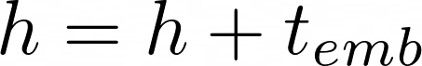
UNet - Conditioning
Shapes: h (H x W x D), t_{emb} (1 x 1 x D)
Method 1: Simple addition
Method 2: Modulation parameters
Group normalization is particularly helpful when dealing with small or variable batches. It works by dividing the channels in a layer into groups and normalizing the resources separately in each group.

Slide 17
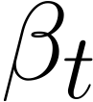





Diffusion Parameters
Noise Schedule
Data
Noise
Above, and control the variance of the forward diffusion and reverse denoising processes respectively.
Often a linear schedule is used for , and is set equal to .
Kingma et al. NeurIPS 2022 introduce a new parameterization of diffusion models using signal-to-noise ratio (SNR), and show how to learn the noise schedule by minimizing the variance of the training objective.
We can also train while training the diffusion model by minimizing the variational bound (Improved DPM by Nichol and Dhariwal ICML 2021) or after training the diffusion model (Analytic-DPM by Bao et al. ICLR 2022).
29

Slide 18
Content-Detail Tradeoff
Reverse denoising process (generative)
Data
Noise
x₀
x₁
x₂
x₃
x₄
…
x_{T}
The denoising model is specialized for generating the high-frequency content (i.e., low-level details)
The denoising model is specialized for generating the low-frequency content (i.e., coarse content)
The weighting of the training objective for different timesteps is important!
31

Slide 19

Connection to VAEs
Diffusion models can be considered as a special form of hierarchical VAEs.
However, in diffusion models:
The encoder is fixed
The latent variables have the same dimension as the data
The denoising model is shared across different timestep
The model is trained with some reweighting of the variational bound.
Vahdat and Kautz, NVAE: A Deep Hierarchical Variational Autoencoder, NeurIPS 2020 Sønderby, et al.. Ladder variational autoencoders, NeurIPS 2016.
32

Slide 20
Summary
Denoising Diffusion Probabilistic Models
Denoising diffusion probabilistic models.
The model is trained by sampling from the forward diffusion process and training a denoising model to predict the noise. We discussed how the forward process perturbs the data distribution or data samples.
The devil is in the details:
Network architectures
Objective weighting
Diffusion parameters (i.e., noise schedule)
See “Elucidating the Design Space of Diffusion-Based Generative Models” by Karras et al. for important design decisions.
33

Slide 21
Stable Diffusion: High-Resolution Image Synthesis with Latent Diffusion Models

Slide 22
Diffusion models (DMs)
Diffusion models (DMs) achieve state-of-the-art synthesis results on images by decomposing the image formation process into a sequential application of denoising autoencoders
These models typically operate directly in pixel space, optimization of powerful DMs often consumes hundreds of GPU days
Inference is expensive due to sequential evaluations.
To enable DM training on limited computational resources while retaining their quality and flexibility alternative ways are required.
This paper employed DM on the latent space of powerful pretrained autoencoders.

Slide 23
Latent Diffusion Models (LDM)
Stable Diffusion is a latent text-to-image diffusion model
Stable Diffusion is based on a particular type of diffusion model called Latent Diffusion model
Proposed by the researchers and engineers from CompVis, LMU and RunwayML.
LDM: instead of applying the diffusion process directly on a high-dimensional input, we project the input into a smaller latent space and apply the diffusion there.
The model was initially trained on 512x512 images from a subset of the LAION-5B database.

Slide 24
Latent Diffusion Models (LDM)
LDM Text-to-Image model
Guided diffusion models
Textual information is also embedded as supervision
This is particularly achieved by encoding text inputs into latent vectors using pretrained language models like CLIP.
Diffusion models can achieve state-of-the-art results for generating image data from texts.

Slide 25
Latent Diffusion Models (LDM)
The process of denoising is very slow and consumes a lot of memory when generating high-resolution images.
It is challenging to train these models and also use them for inference.
By introducing cross-attention layers into the model architecture, the diffusion models are turned into powerful and flexible generators for general conditioning inputs such as text or bounding boxes
High-resolution synthesis becomes possible in a convolutional manner.

Slide 26
Latent Diffusion Models (LDM)
Latent diffusion can reduce the memory and computational time by applying the diffusion process over a lower dimensional latent space
No more using the actual pixel space.
In latent diffusion, the model is trained to generate latent (compressed) representations of the images.

Slide 27


Latent Diffusion Models (LDM)
“a photograph of an astronaut riding a horse”

Slide 28
Latent Diffusion Models (LDM)
Image diffusion model learn to denoise images to generate output images.
Stable Diffusion uses latent images encoded from training data as input.
Given an image zo, the diffusion algorithm progressively add noise to the image and produces a noisy image zt, with t being how many times noise is added.
When t is large enough, the image approximates pure noise.
Given a set of inputs such as time step t, text prompt, image diffusion algorithms learn a network to predict the noise added to the noisy image zt.

Slide 29

Latent Diffusion Models (LDM)
We generate some noise, and add it to the image
We can easily control how much noise to add to the image
Spread it over tens of steps.

Slide 30

Latent Diffusion Models (LDM)
Train the noise predictor using UNet
Problem: Too complex and will be very difficult to train and slow in prediction

Slide 31

Latent Diffusion Models (LDM)

Slide 32
Latent Diffusion Models (LDM)
Three main components of Stable Diffusion:
CLIP for text encoding. Input: text. Output: 77 token embeddings vectors, each in 768 dimensions.
UNet + Scheduler to gradually process/diffuse information in the information (latent) space. Input: text embeddings and noise. Output: A processed information array
Autoencoder Decoder Generate final image using the processed information array. Input: The processed information array (dimensions: (4,64,64)) Output: The resulting image (dimensions: (3, 512, 512) which are (red/green/blue, width, height))

Slide 33
Contrastive Language-Image Pre-training (CLIP)
Enables image classifiers trained with natural language supervision at large scale.
A new dataset of 400 million (image, text) pairs
Contrastive Language-Image Pre-training(CLIP) is trained to learn the relationship
An efficient method of learning from natural language supervision.
CLIP, similar to the GPT family, learns to perform a wide set of tasks: OCR, geo-localization, action recognition, and many others.

Slide 34
Contrastive Language-Image Pre-training (CLIP)
The Text Encoder: A Transformer Language Model
A Transformer language model is used as the language understanding component that takes the text prompt and produces token embeddings.
The released Stable Diffusion model uses ClipText (A GPT-based model)
We can also use other like BERT.
Much larger OpenCLIP variants of CLIP

Slide 35

CLIP

Slide 36

CLIP
Learning Transferable Visual Models From Natural Language Supervision Alec

Slide 37

CLIP

Slide 38


Variational Auto Encoder
VAE

Slide 39

UNet
Additionally add some self-attention layers at lower resolutions

Slide 40

Combined (LDM)

Slide 41

Latent Diffusion Model

Slide 42
UNet - Conditioning
Condition on diffusion timestep t
UNet
x_{t}
MLP
ε_{t}
t
Sinusoidal Embedding
B x 1
B x D
B x D

Slide 43
UNet - Conditioning
Shapes: h (H x W x D), t_{emb} (1 x 1 x D)
Method 1: Simple addition
Method 2: Modulation parameters

Slide 44

Latent Diffusion Models

Slide 45
Summary: Latent Diffusion Models
The main change to the system:
add support for text inputs (technical term: text conditioning)
an attention layer between the ResNet blocks.
ResNet block doesn’t directly look at the text.
Attention layers merge those text representations in the latents.
ResNet can utilize that incorporated text information in its processing.
Work in latent space

Slide 46
References
Rombach, R., Blattmann, A., Lorenz, D., Esser, P., & Ommer, B. (2021). High-Resolution Image Synthesis with Latent Diffusion Models. Proceedings of the IEEE Computer Society Conference on Computer Vision and Pattern Recognition, 2022-June, 10674–10685. https://doi.org/10.1109/CVPR52688.2022.01042
Radford, A., Kim, J. W., Hallacy, C., Ramesh, A., Goh, G., Agarwal, S., Sastry, G., Askell, A., Mishkin, P., Clark, J., Krueger, G., & Sutskever, I. (2021). Learning Transferable Visual Models From Natural Language Supervision. Proceedings of Machine Learning Research, 139, 8748–8763.

Slide 47
References
https://lilianweng.github.io/posts/2021-07-11-diffusion-models
https://www.louisbouchard.ai/latent-diffusion-models/
https://openai.com/research/clip
https://arxiv.org/pdf/2103.00020v1.pdf
Deep Unsupervised Learning by Pieter Abbeel et al.

Slide 48
Thank You ☺

